Slide 1


SPAM FILTER USING BAYES THEOREM

Slide 2
PRESENTED BY:
ANUSHA V
YASINI S
HARIHARAN G
ABISHEK
ABHINAV M

Slide 3

Introduction
Spam emails are unwanted or harmful emails.
A spam filter automatically identifies and removes such emails.
We use Naive Bayes Theorem to classify emails as spam or not spam.
It is one of the simplest and most effective classification techniques in NLP

Slide 4
Objective
To build an email spam classifier.
To implement Naive Bayes algorithm for text classification.
To understand how mathematical probability helps in real-world applications like spam filtering.

Slide 5
What Are the Mathematical Concepts Used?
Bayes Theorem
Conditional Probability
Probability Distribution
Text Preprocessing (TF/IDF, tokenization, etc.)
Log Likelihood

Slide 6
Explain the concept in depth
Bayes Theorem:
P(A|B) = P(B|A).P(A)/P(B)
A = message is spam
B = set of words in the email
We calculate:
°P(Spam|Words)
°P(Not Spam|Words)
The classifier chooses the higher of the two.
Naive Assumption: All features (words) are independent.

Slide 7
CODE
import pandas as pd
from collections import defaultdict, Counter
import re, math
import matplotlib.pyplot as plt
# ✅ Load the CSV file
df = pd.read_csv(r"C:\Users\tebin\Desktop\Inlustro- P1\email2-100.csv") # Adjust path if moved
# ✅ Function to clean and split email text
def extract_words(text):
return re.sub(r'[^a-z0-9\s]', '', str(text).lower()).split()
# ✅ Initialize word counts and counters
spam_words, nonspam_words = defaultdict(int), defaultdict(int)
spam_count = nonspam_count = 0
# ✅ Count word frequencies for spam and non-spam
for _, row in df.iterrows():
words = extract_words(row['text']) # Ensure the column is named 'text'
label = str(row['LABEL']).strip().lower() # Use 'LABEL' column
if label == 'spam':
spam_count += 1
for word in words:
spam_words[word] += 1
elif label == 'non-spam':
nonspam_count += 1
for word in words:
nonspam_words[word] += 1
# ✅ Prior probabilities and vocabulary
total_emails = spam_count + nonspam_count
p_spam = spam_count / total_emails
p_nonspam = nonspam_count / total_emails
vocab = set(spam_words) | set(nonspam_words)
V = len(vocab)
# ✅ Word probability with Laplace smoothing
def word_prob(word, label):
if label == 'spam':
return (spam_words[word] + 1) / (sum(spam_words.values()) + V)
else:
return (nonspam_words[word] + 1) / (sum(nonspam_words.values()) + V)
# ✅ Classifier function
def classify(email):
words = extract_words(email)
spam_log = math.log(p_spam)
nonspam_log = math.log(p_nonspam)
for word in words:
spam_log += math.log(word_prob(word, 'spam'))
nonspam_log += math.log(word_prob(word, 'non-spam'))
return 'spam' if spam_log > nonspam_log else 'non-spam'
# ✅ Accuracy evaluation
correct = sum(classify(row['text']) == str(row['LABEL']).strip().lower() for _, row in df.iterrows())
print(f"\n✅ Accuracy: {correct / len(df):.2%}")
# ✅ Confusion matrix
conf = Counter((str(row['LABEL']).strip().lower(), classify(row['text'])) for _, row in df.iterrows())
print("\n📊 Confusion Matrix:")
print(f"{'':<17}{'Pred Non-spam':<15}{'Pred Spam'}")
print(f"{'Actual Non-spam':<17}{conf[('non-spam','non-spam')]:<15}{conf[('non-spam','spam')]}")
print(f"{'Actual Spam':<17}{conf[('spam','non-spam')]:<15}{conf[('spam','spam')]}")
# ✅ Plotting top 10 spam/non-spam words
def plot_top_words(word_dict, label):
top = sorted(word_dict.items(), key=lambda x: x[1], reverse=True)[:10]
words, counts = zip(*top)
plt.bar(words, counts, color='red' if label == 'spam' else 'green')
plt.title(f"Top 10 {label.capitalize()} Words")
plt.xticks(rotation=45)
plt.tight_layout()
plt.show()
plot_top_words(spam_words, 'spam')
plot_top_words(nonspam_words, 'non-spam')
# ✅ Optional: Try custom input
while True:
test_email = input("\n✉️ Enter a test email (or type 'exit' to stop):\n> ")
if test_email.strip().lower() == 'exit':
break
result = classify(test_email)
print(f"🧠 This email is classified as: {result.upper()}")

Slide 8
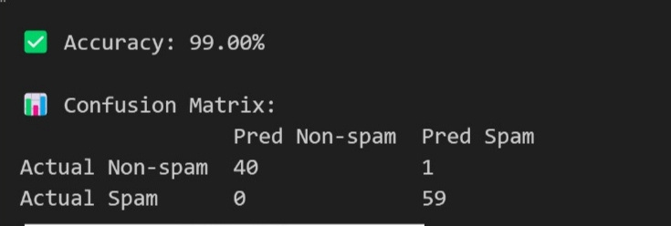
OUTPUT

Slide 9
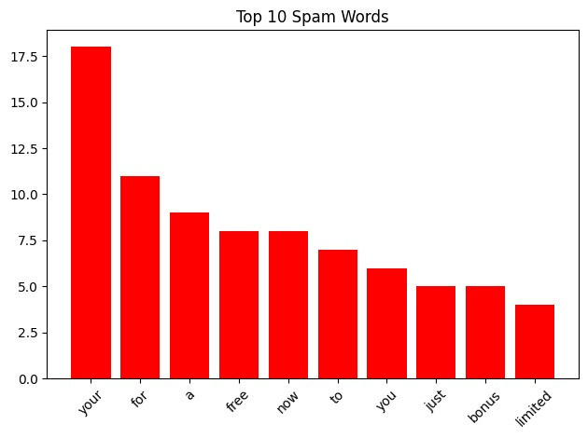

Slide 10
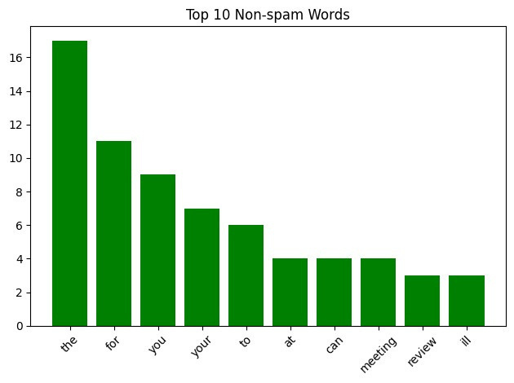

Slide 11
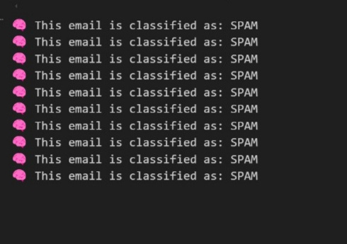

Slide 12
Conclusion
Naive Bayes is fast and effective for spam filtering.
Works well even with a small training dataset.
Ideal for real-time applications like email filtering.

Slide 13
Fucture scope
Implement on live email data (Gmail/Outlook integration).
Improve accuracy using TF-IDF and NLP techniques.
Extend for phishing or scam message detection.
Use in chatbots or messaging platforms.

Slide 14

Thank you

